Slide 1
SUSTAINABILITY GREEN CLAIMS
and GREEN WASHING
May 16, 2023

Slide 2
Agenda
Introductions
What are green claims and why are they used?
Green claims data and research
When are green claims an offence?
Regulatory overview and European Directive
Navigating the challenges

Slide 3
Introductions

Slide 5
What Are Green Claims
and Why Are They Used

Slide 6
Providing the consumer reliable and understandable information on the environmental performance of product and services.

Slide 7
GREEN CLAIMS ARE PROLIFIC
Marketing of green claims in advertising has exploded. It refers to explicit messaging that implies that the product or service:
Has environmental benefits
Is less harmful to the environment
Is better for the environment that a competitor’s product

Slide 8
A GREEN CLAIM:
Any commercial communication (including logos, symbols and photographs) aimed at suggesting or evoking a minor or reduced environmental impact of the product and/or service offered (including the "packaging")

Slide 9
Green claims leverage consumer interest in two areas:
ENVIRONMENTAL IMPACT
ENERGY SAVING
Consumer perception related to environmental protections
Consumer perception related to energy saving

Slide 10
RENEWABLE ENERGY SOURCES
MATERIALS WITH LESS ENVIRONMENTAL IMPACT
EFFIECENT USE OF NATURAL RESOURCES
LONGER PRODUCTS LIFE EXPECTANCY
FREE FROM
CHEMICALS
IMPROUVED ENERGY PERFORMANCES

Slide 11
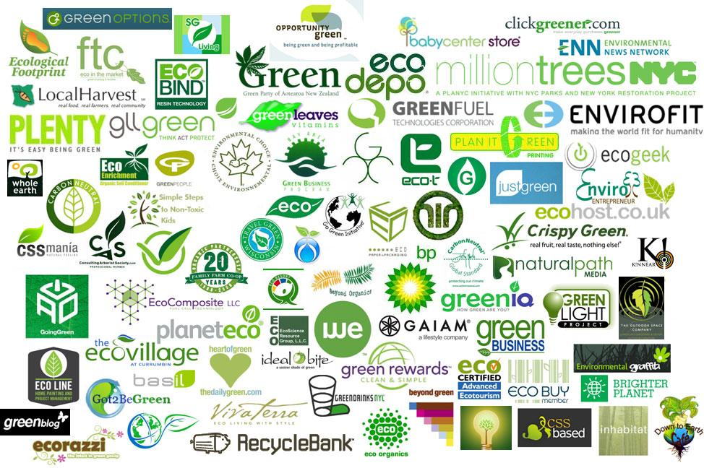
decreto legislativo 116/2020
Environmental claims come in:
Logos
Text
images and colors

Slide 12
Green Claims Data and Research

Slide 13
94% of Europeans say that protecting the environment is important to them
68% agree that their consumption habits adversely affect the environment in Europe
Data: European Commission 2020

Slide 14
78%
53%
“sometimes” or “never” believe environmental claims
but only
of Americans believe companies should be environmentally responsible
of Americans

Slide 15
Consumer Trust In Green Claims is Very Low
“Eco-Friendly”
“Green”
“Sustainable”
The huge variety of VAGUE green claims was also found to undermine consumer trust, as labels differ widely in robustness and reliability, leading to widespread scepticism.
61%European consumers do not trust or even understand green claims
Data: European Commission 2020
of Americans

Slide 16
Characteristics of appropriate environmental claims
CLARITY
OBJECTIVITY
TRUTHFULNESS
COMPARABILITY
COMPLETNESS
TRANSPARENCY

Slide 17
When is Greenwashing an Offense

Slide 18
Greenwashing is the habit of making environmental claims without any or little evidence and substantiation backing these claims, in order to make products or processes to appear more environmentally friendly than they truly are.

Slide 19
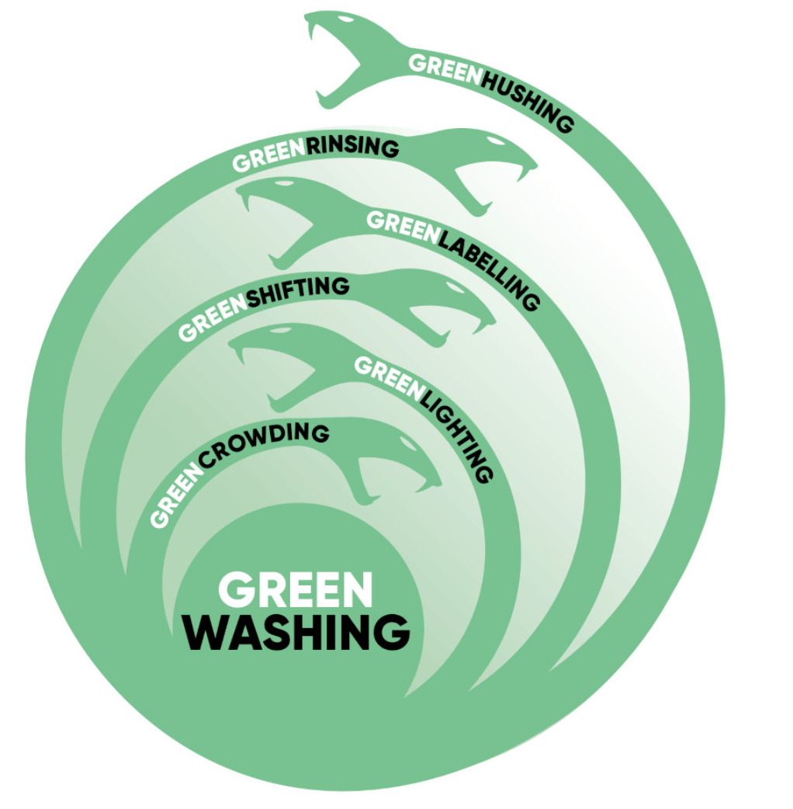
Different Types of Greenwashing
greencrowding - safety in numbers
greenlabeling- marketing something as sustainable, but claim is misleading
greenlighting - highlight something small that is draw attention away from unsustainable practices
greenshifting - blaming the consumer
greenrinsing - regularly changing ESG targets before they are met
greenhushing - under-reporting or hiding sustainability credentials
Image credit: Planet Tracker
of Americans

Slide 20
Untrustworthy Claims Lead To:
Consumer confusion and lack of trust
Uneven playing field for companies
Costs to business operating across borders
of Americans

Slide 21
Companies can use voluntary generic, evocating, suggestive or even false and not substantiated green claims taking advantage of a regulatory vacuum.
Green claims are not regulated by a specific discipline but can be persecuted as:
- misleading for customers
- unfair practices to companies that are genuinely working to improve their environmental performance.

Slide 22
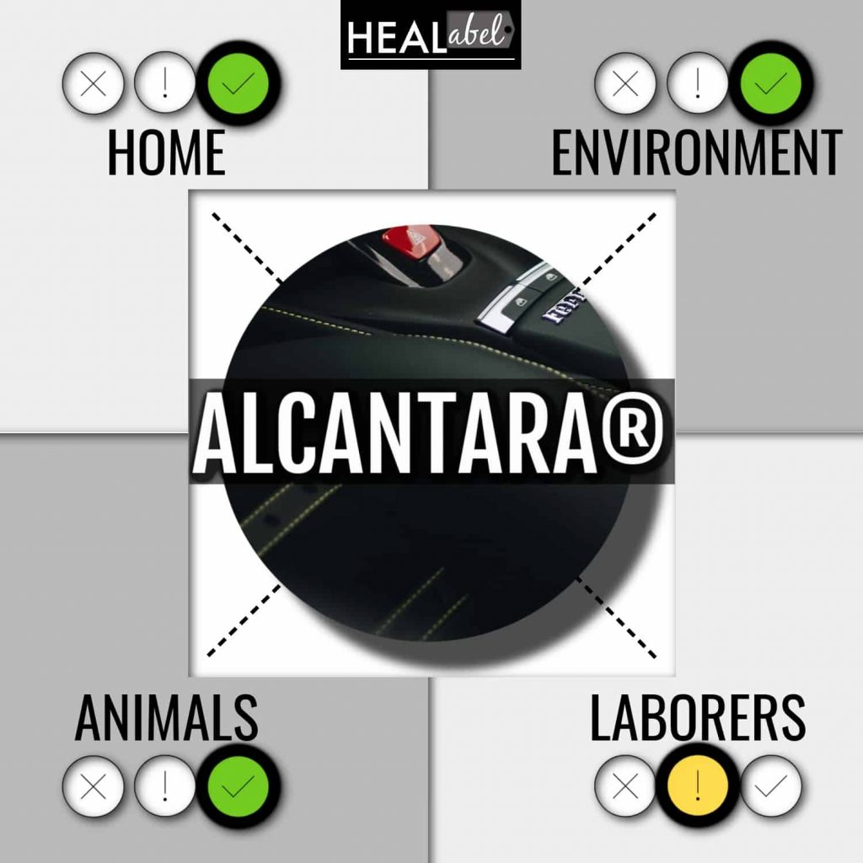
The Court of Gorizia noted that the advertising messages used by the respondent company contained references to environmental advantages that were not verifiable or were completely generic and suitable for confuse potential recipients.
Negative effects towards two directions:
towards final consumers who could be induced to buy goods/services which appeared to be eco-friendly, but which probably were not;
towards other companies, since the adoption of such illegitimate advertising has granted a competitive advantage a caused a case of unfair competition.

Slide 23
USA: Behind Europe but advancing legislation
California SB 343 benchmarks in order to be advertised or labeled as recyclable
California AB 1201 Biodegradable, Compostable Claims on Packaging or labeling must meet ASTM requirements
California vs Endo Plastics “Biodegradable plastic water bottle” claims as false and misleading.
TerraCycle Settlement “Free” recycling not available to all customers
of Americans

Slide 24
VAGUE:
SPECIFIC:
general
imprecise
real meaning is not understood by the consumer;
concrete and specific environmental aspects;
avoiding vague statements.
generic main message must be accompanied by visible specifications
allow a complete and intelligible reading of the information.

Slide 25
IRRELEVANT:
RELEVANT:
suggests a product is "green" based on a limited set of characteristics, without paying attention to other important environmental problems;
the statements may be true, but are not relevant or do not help consumers in their choices
about significant aspects for the specific product/process
takes into consideration full life cycle.
don't give false credit

Slide 26
GOBBLEDYGOOK:
CLEAR:
claim adopts meaningless wording
made to be unintelligible by the excessive use of abstruse technical terms that the average person cannot easily understand
average consumer cannot verify
clarity of terms
comprehensibility of the consumer’s language in
clarity of the object of the environmental information (product, process, activity, packaging, etc.), legibility, absence of ambiguity and possible misunderstandings

Slide 27
INCONSINSTENCY:
COHERENCE:
statements may be true within a specific category of products, but tend to distract the consumer from the fact that the consumption of that specific product in itself has a great environmental impact;
Claims are consistent with the context in which a product is manufactured, distributed and consumed.
For example, the advantages deriving from the recyclability of a product cannot be claimed if it is marketed in a territorial context in which the unavailability of assets for recycling makes it not actually feasible.

Slide 28
FALSE
TRUTHFUL AND VERIFIABLE
False green claims
environmental declarations that are not supported by easily verifiable data or scientific evidence, or assessed by independent certifications.
Verifiable information through reference to sources, specific data or demonstrate its reliability
third-party verifications and certifications
claims must be based on reliable data, obtained by applying widespread, recognised, scientifically based and reproducible methodologies.

Slide 29
LACK OF COMPARABILITY
COMPARABILITY
comparison (to competitors or with another or precedent model), the object and terms of the comparison must be detailed.
terms of comparison must be absolutely clear and unequivocal, clarifying a whole series of elements, including references to the time period, the parameters, the calculation methodology…
claims are based on a comparison (“greener,” “more sustainable,” “reduced environmental impact”) but not supported by easily verifiable data, information or evidence of exactly what they refer to.

Slide 30
KEY TAKEAWAYS
Greenwashing is an attempt to capitalize on the growing demand for environmentally sound products.
Greenwashing can convey a false impression that a company or its products are environmentally conscious or friendly.
Critics have accused some companies of greenwashing to capitalize on the socially responsible or environmental, social, and governance (ESG) investing movement.
Genuinely green products or businesses back up their claims with facts and details.

Slide 31
How to Navigate The Challenges

Slide 32
Lacking of Common criteria on how companies should substantiate environmental claims
Clear requirements to address the proliferation and credibility challenges of environmental labels
The Commission is proposing new rules to stop companies from making misleading claims about environmental merits of their products and services and allow consumers to make informed environmental choices.

Slide 33
The proposal for a Directive on Green Claims will address greenwashing by tackling false environmental claims made towards consumers, and stopping the proliferation of public and private environmental labels.

Slide 34
NEW EU DIRECTIVE PROPOSAL ON GREEN CLAIMS
Claims must be substantiated with scientific evidence that is widely recognised, identifying the relevant environmental impacts and any trade-offs between them
If products or organisations are compared with other products and organisations, these comparisons must be fair and based on equivalent information and data.
Claims or labels that use aggregate scoring of the product's overall environmental impact on, for example, biodiversity, climate, water consumption, soil, etc., shall not be permitted, unless set in EU rules.
Environmental labelling schemes should be solid and reliable, and their proliferation must be controlled.

Slide 35
In the black list of unfair practices
prohibited in all circumstances
will be included:
1
ban on the use of generic environmental claims in consumer marketing activities
“FRIEND OF NATURE”
“NATURAL CHOICE”
“ENVIRONMENTALLY FRIENDLY”

Slide 36
In the black list of unfair practices
prohibited in all circumstances
will be included:
2
prohibition of making an environmental claim concerning the product as a whole when in reality it concerns only a certain aspect brings substantial benefits to consumers
THE PRODUCT IS PRESENTED AS CARBON NEUTRAL, BUT IN REALITY THE CLAIM IS ONLY REFERRED TO THE PACKAGING

Slide 37
NEW EU DIRECTIVE: EXPECTED BENEFITS
FOR CONSUMERS:
Prevention of greenwashing
Reliable, comparable and verifiable environmental information on products accessible to everyone
Environmental labels and claims are credible and trustworthy
Consumers to make better informed purchasing decisions and contribute to the green transition
Stop proliferation of environmental labels
FOR COMPANIES:
Common approach for green claims across the EU companies to compete on a level playing field
Boosting competitiveness of economic operators who increase the environmental sustainability of their products and activities
Increasing credibility for EU businesses trading across the EU
More demand for greener products and solutions

Slide 38
use generic and vague expressions, such as "sustainable", "ecological", ”eco-friendly", "the product that loves nature" without a precise meaning
do not claim characteristics common to all similar products, or due to legal requirements, such as "free of chlorofluorocarbons” or “OGM free”
do not use green marketing without a sustainability strategy to back up your business

Slide 39
substantiate eco-sustainability claims with appropriate environmental footprint tools and methodologies
avoid practices that can be considered contrary to professional diligence and likely to appreciably distort the economic behavior of the average consumer
pursue sustainable business practices internally before you share sustainable successes externally. Seek advise from specialists like the Pet Sustainability Coalition or Mia Solutions

Slide 40
Be open and transparent. Use your website to provide consumers specific data on your products. Today’s consumer values honesty.
Back up an claims through validated, authoritative and accredited third-party certifications

Slide 41
WE ARE
retailers, distributors, manufacturers & brands
TAKING ACTION!
AB7 America Inc.
ADM
Alaska Naturals
All The Best Pet Care
Alltech
Alphia
Animal Essentials Inc
Annamaet Petfoods Inc.
Antelope Pet (Bocce's Bakery)
Austin and Kat
Ava's Pet Palace
Bark n Purr
Bark Potty LLC
Beaphar
Bend Pet Express
BetterBone
Dogwood Consulting
Duynie Ingredients
Earth Rated
Earth's Goodies
Earthbath
Earthwile Endeavors
Eco-Shell
Emmerson Packaging
Ethical Products, Inc.
FiberCore, LLC
Fish4Dogs
Flamingo Pet Products
Grandma Lucy’s
Green Field Solutions
Health Extension
Heather Paulsen Consulting
New Age Pet
Nulo
Nylabone
Outward Hound
Oxbow Animal Health
Pet Food Manufacturing Association
PetDine
Pet Friendly Fun
Pet Valu
PetDine LLC
Piscine Energetics Inc.
Plastic Packaging Technologies
Polkadog
Portland Pet Food Company
PreZero, US
Trident Seafoods DBA: Alaska Naturals
Trío Goods for a Cause
Trixie
Trouw Nutrition
tru Shrimp Company
Two Bostons
Veramaris V.O.F.
Vitamin K9
W.F. Young aka The Missing Link
Vivotein LLC
Weruva International
WJ Packaging Solutions
Zooplus
BHJ A/S
Bond Pet Foods
Boons
Boxiecat LLC
Bright Planet Pet LLC
BrightPet Nutrition Group
BSM Partners
California Safe Soil (CSS)
Canna Companion
Catalyst Pet (Lignetics)
Chews Happiness
Consolidated Packaging
Cosmo's Superior Foods
Dharma Dog Karma Cat
Dingonatura
Do Good Foods
Hedgehog Precision
Hood Packaging InClover
inClover Research
Interquell
IQI
Josera
Kinn Inc.
Kiwi Kitchens
Mammoth Pet Products
Moderna Products
Molly Mutt
Mondi Jackson LLC
Montana Dog Food Co
MPM Products UK
NatrixOne
Necoichi Inc.
Prospect Farms
Protix
Pure and Natural Pet
ROGZ
Rural Energy Development
Shameless Pets
Steves Real Food
SYMRISE (Diana Petfood)
Tender & True Pet Nutrition
Thành Phú
The Crump Group Inc.
The Honest Kitchen
The Kind Pet
The Missing Link
The Natural Dog Company
Toms & Co
*PSC Accredited Brands are in color or bolded

Slide 42
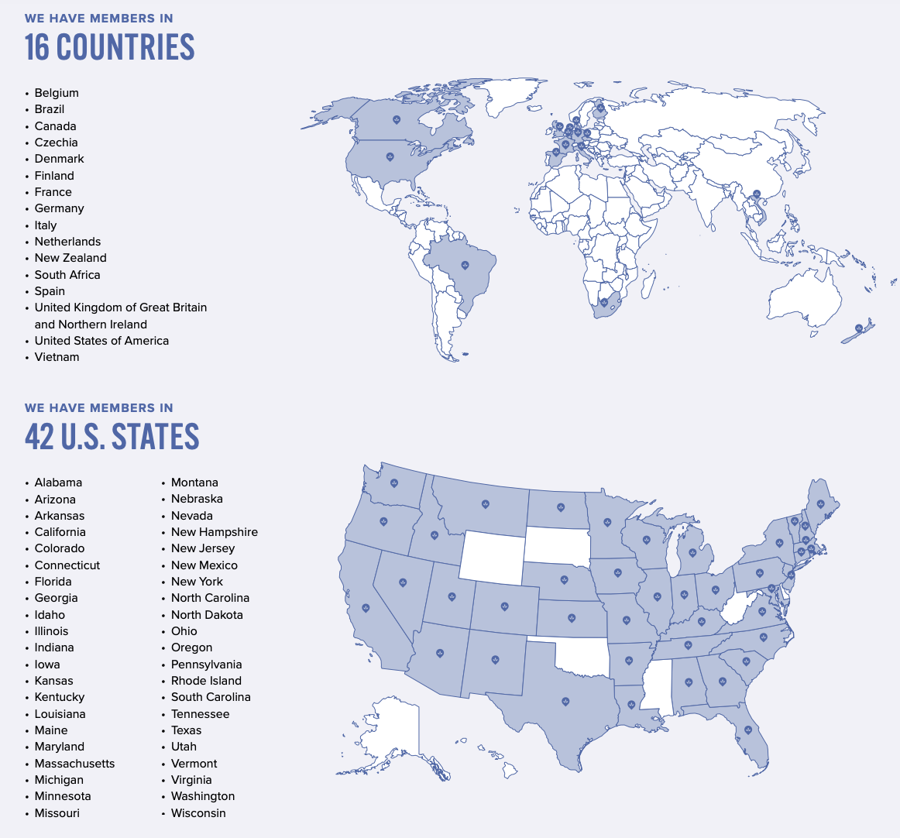

Slide 44
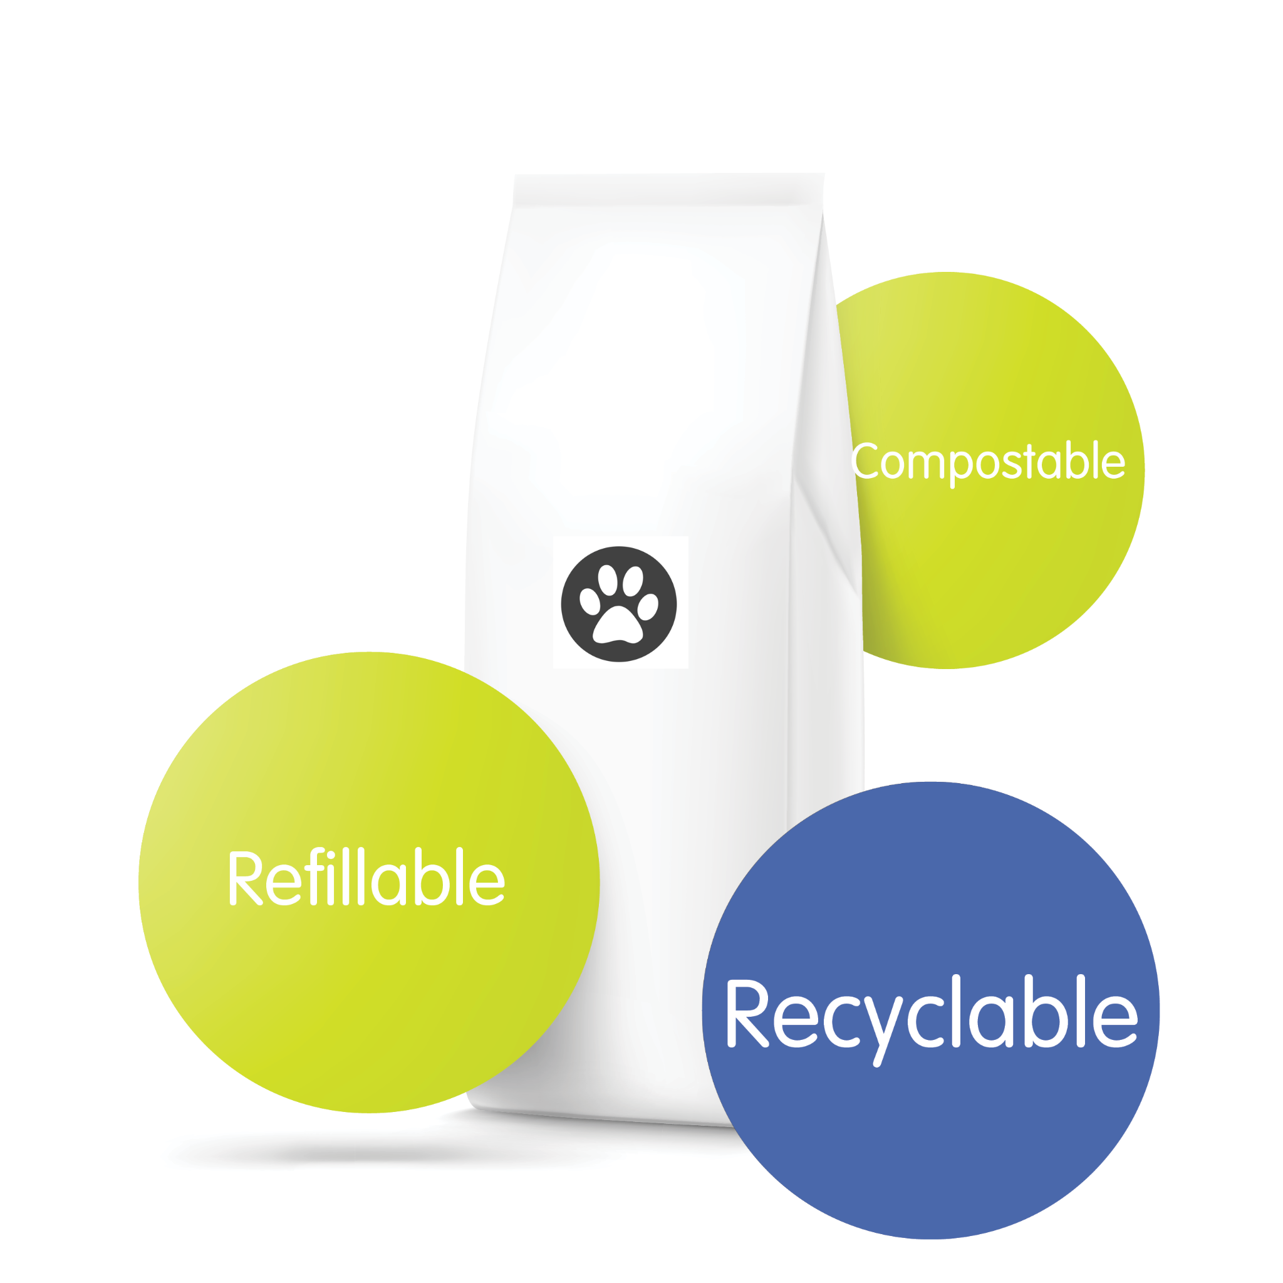
PSC Packaging Pledge
“We commit to transitioning toward recyclable, refillable and compostable packaging by 2025”
The pet industry’s pathway toward sustainable packaging by 2025

Slide 45
SIGNATORY BENEFITS
01
Packaging Benchmarking and Reporting Tools
02
Business Case Support
03
Legislative Updates and Fee Calculator
04
Signatory Badge and Digital Assets
05
Peer Working Groups
06
Supplier Marketplace
Notes:
Europe is the number 2 demand market for flexible packaging and #1 supply market for flexible packaging. While flexible pet food pouches are the most common pack time for European pet food launches, they are the least likely to claim recyclability.

Slide 46
Join PSC
Take the SDG Action Manager Assessment
Become Accredited
Sign the PSC Packaging Pledge
Take advantage of FREE tools and resources at www.petsustainability.org

